Slide 1

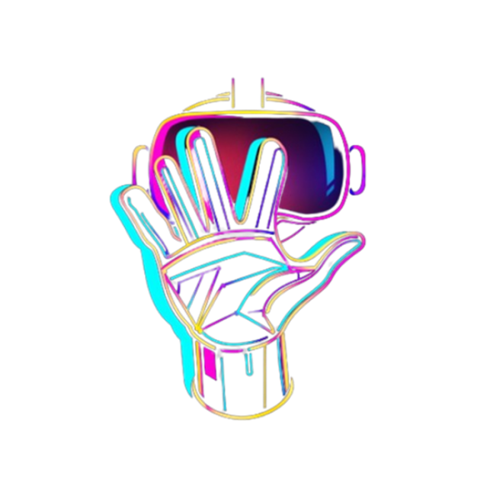
Final Design Review
Smart VR Gloves
Magic Mitts
Affordable Immersive VR Gloves
Team Members
Rabiat Sadiq, Blake Novosad,
John Navarro, Juan Casillas
Advisor
Ryan Saavedra

Slide 2
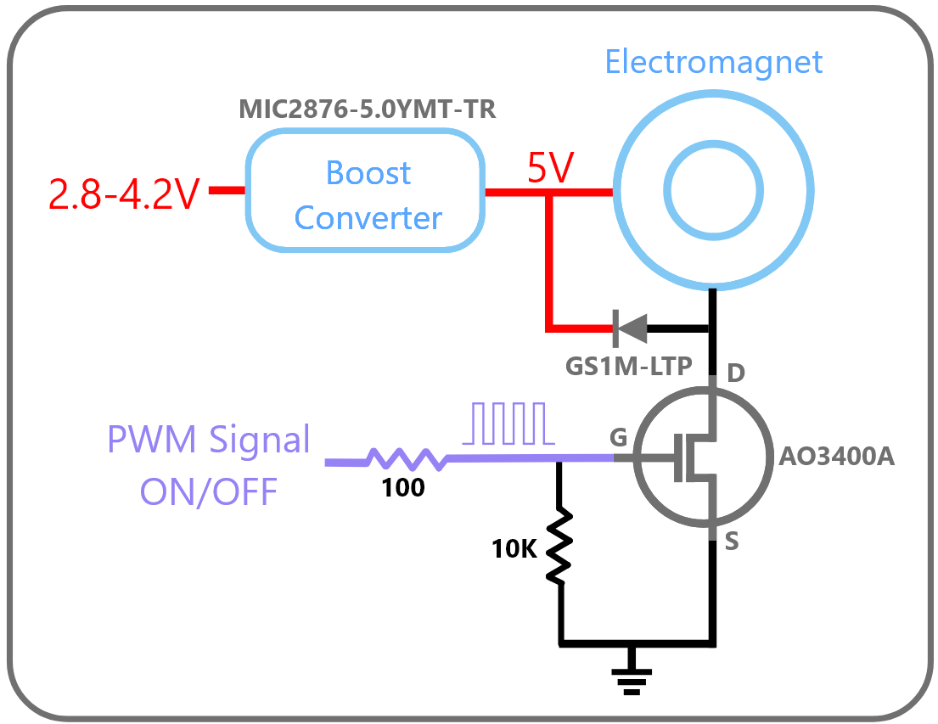
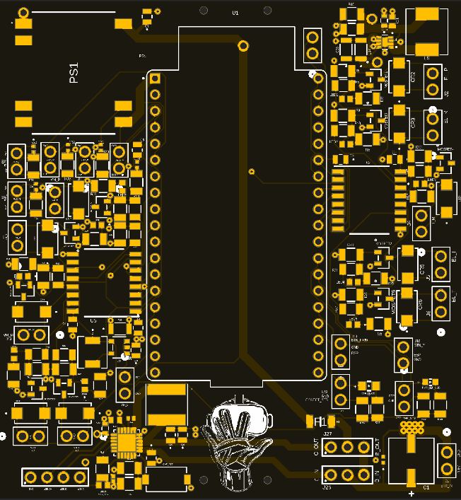
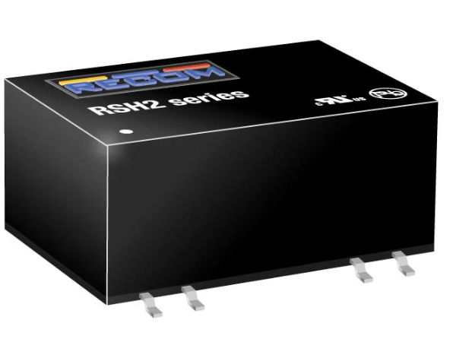
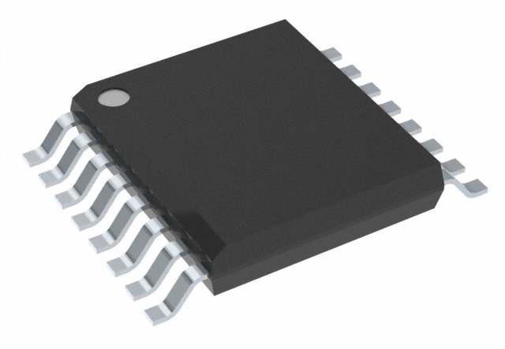
John Navarro’s Contribution
Critical Redesign of PCBA
Critical power management redesign was brought to our attention 35 days before tech symposium
Unable to use boost converter enable lines, need to use more MOSFET switches
Added 4 key new components :
1 Isolated Boost Converter IC
2 Isolated Signal Integrity IC
5 More Mosfets
1 Resettable Fuse
MOSFET Switching
Isolated Boost IC
Isolation IC
Final PCB Preview

Slide 3
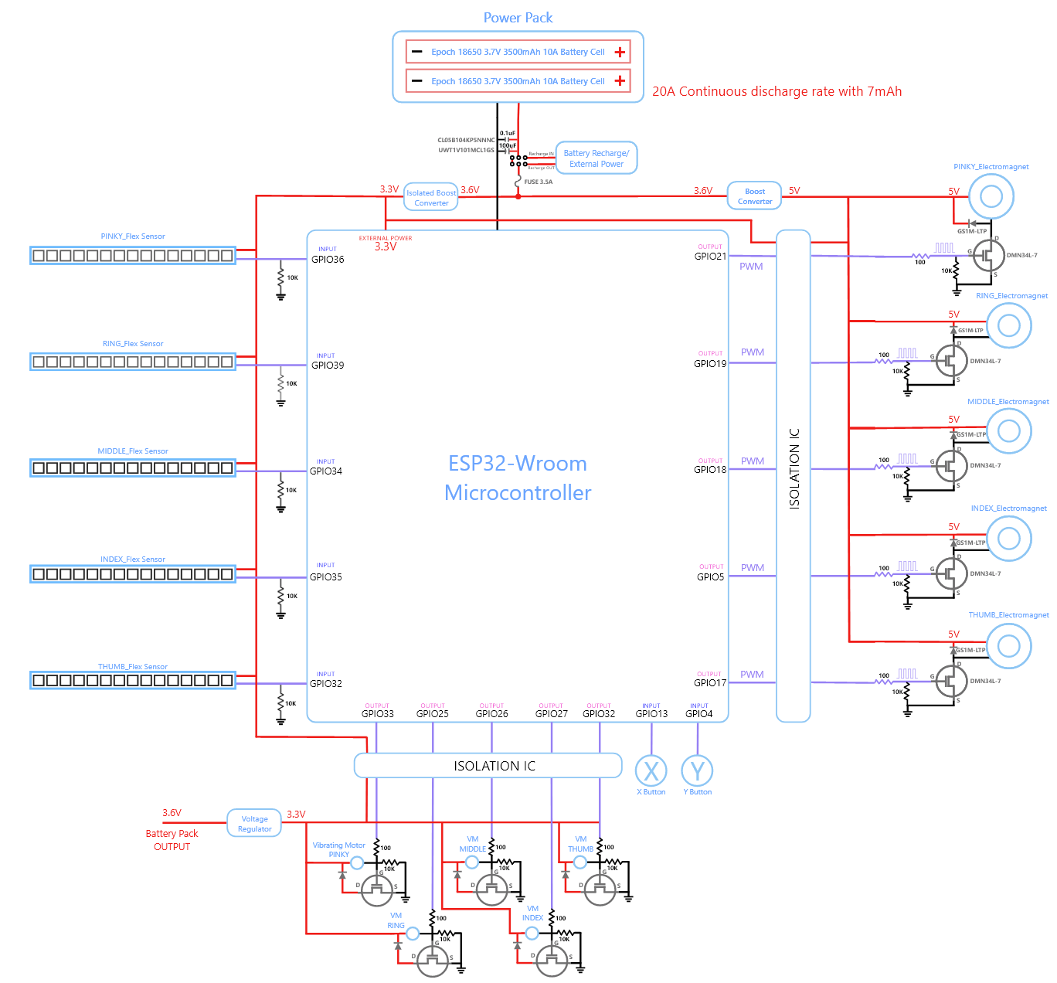
PDF Schematic Links
Complete Detailed Schematic
High Level Schematic

Slide 4
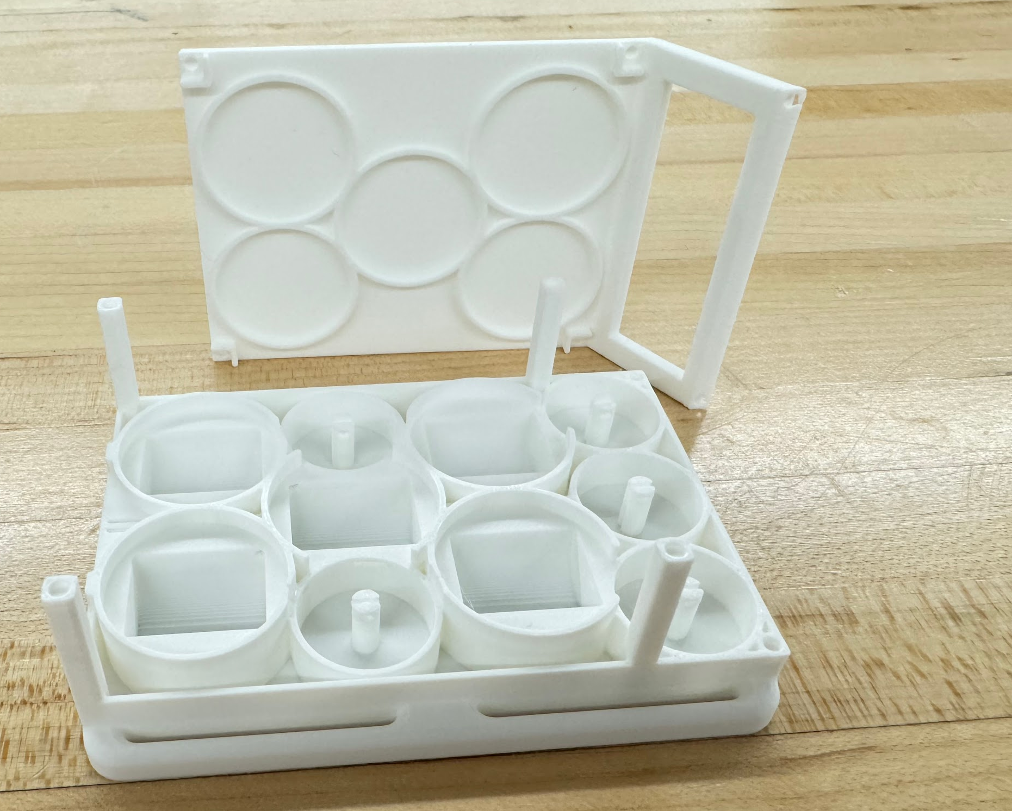
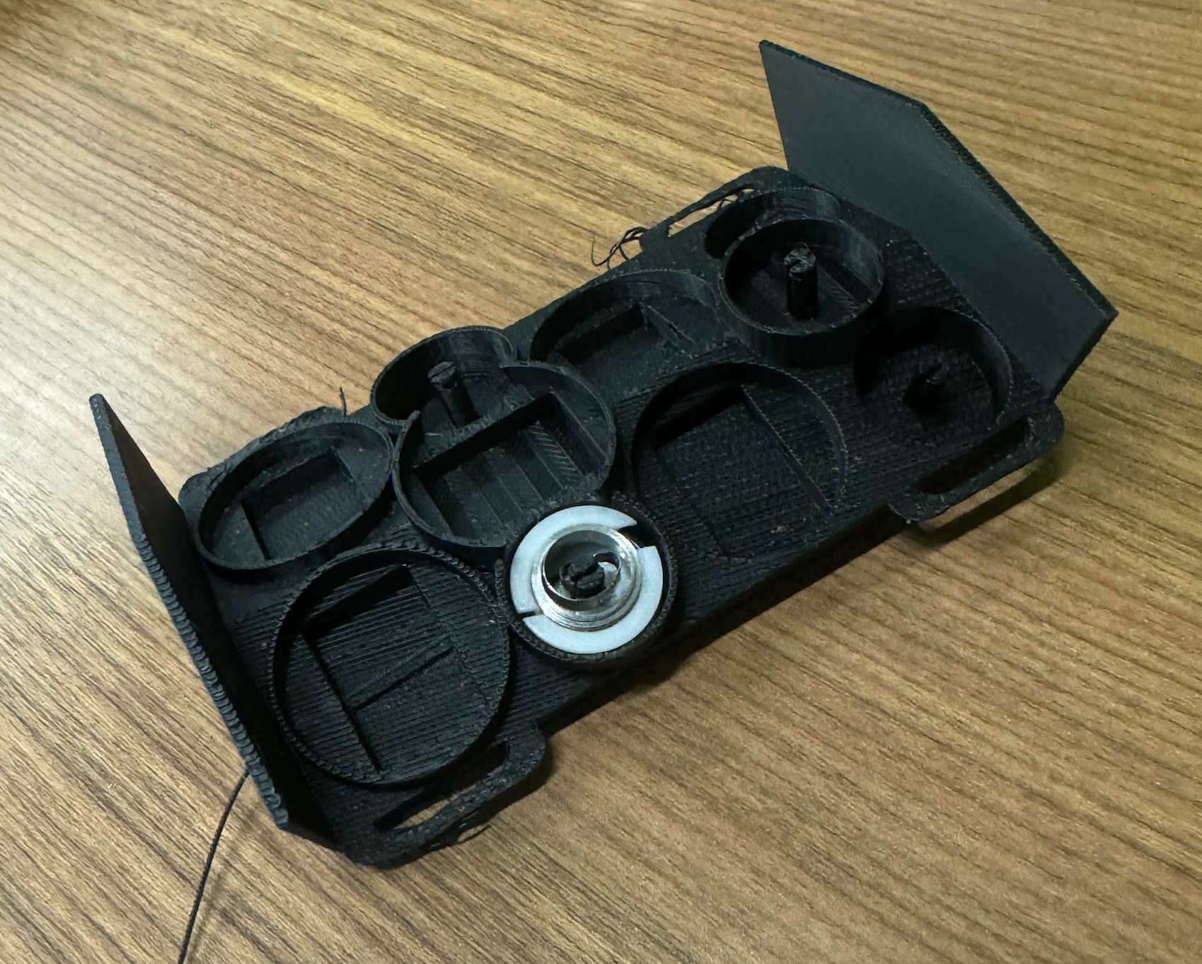
John Navarro’s Contribution
Old Electromagnetic Design
Curved Electromagnetic Housing Design
Designed with a smaller surface area on the users wrist/forearm (comfortable for more users)
Increased spatial airflow between each individual electromagnetic coil
Extremely complex roof design that houses PCBA and routes more than 40 wires
Changed electromagnetic coil (EC) component
Old: Uxcell P25/20 EC (5V, 0.53A, 25mm Diameter)
New: Adafruit P25/20 EC (5V, 0.33A, 25.2mm Diameter)
New Electromagnetic Design

Slide 5
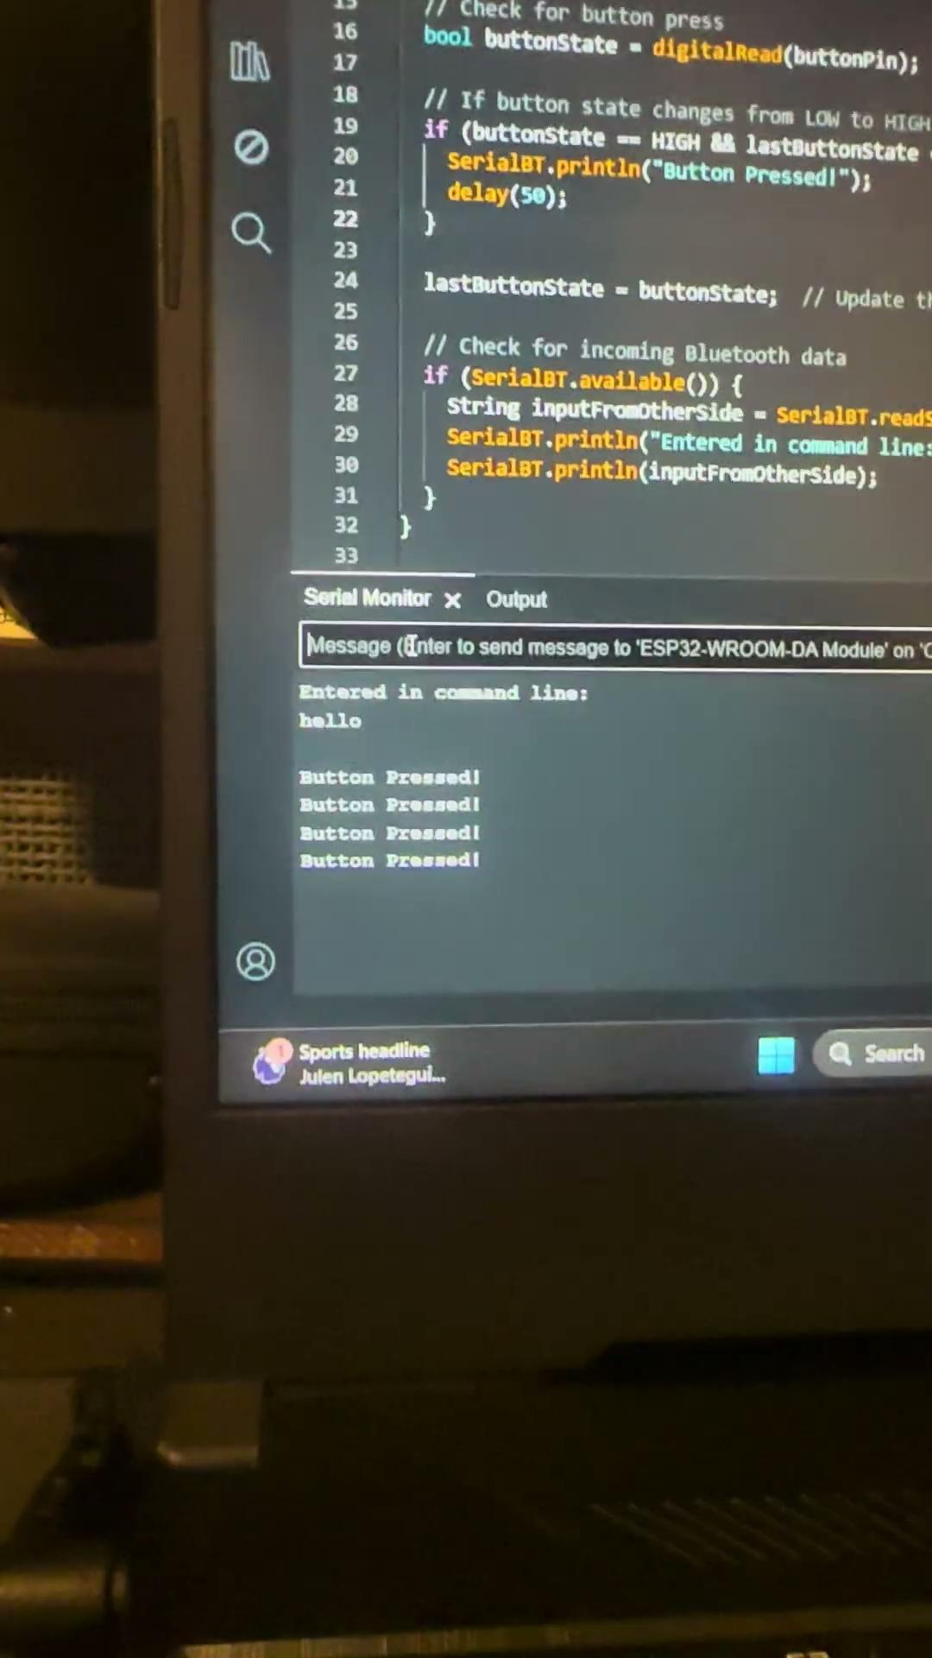
Juan Casillas Contribution
Bluetooth Connectivity
Attained bi-directional communication via BT communication
Initial BT communication through serial command while external power to ESP32
Button input transmitted through BT and output to serial monitor
Issues were mainly the use of correct COM port with proper BT initialization
Bluetooth factors to consider
BT latency when compared to serial connection
Optimization for faster transmission over bluetooth
Proper BT pairing
Maintain strong connection

Slide 6
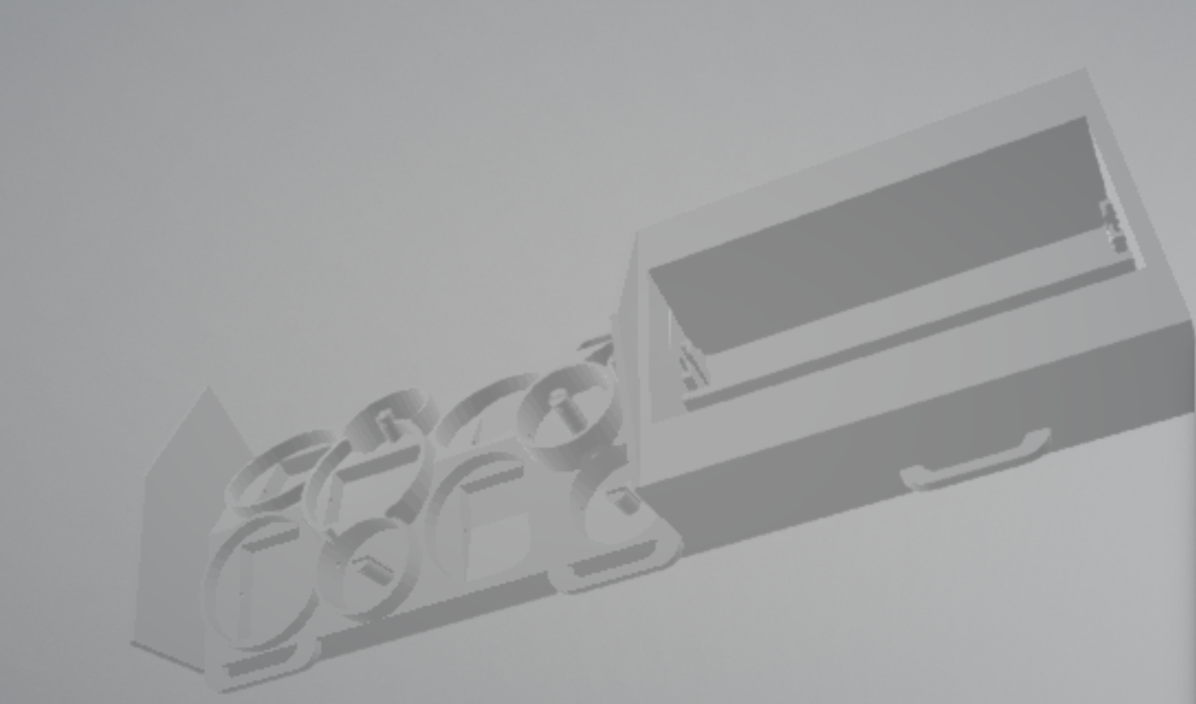
Blake Novosad’s Contribution
Combination Model
combine battery pack with electromagnetic braking system
need to add lids and housing for PCB
Current Combination STL

Slide 7
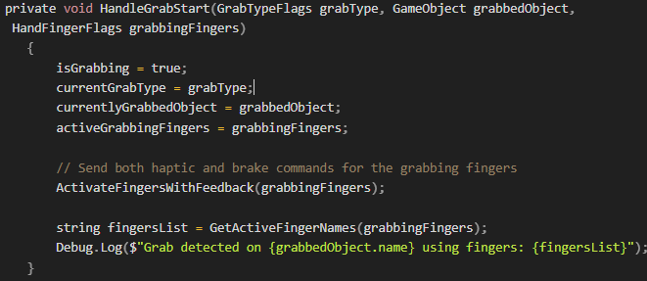
Rabiat’s Contribution
Recent Code Updates & System Integration
Identifying Types of Grab
Grabbing detection
Identifying Types of Grab in VR space to send to Microcontroller
Implemented Oculus SDK HandGrabInteractable for precise grab recognition
Added real-time GUI display showing:
Current grab state
Active grabbing fingers
Grab type (pinch vs. full hand)
Object being grabbed
Notes:
Testing Multiple Scenarios
Tested various object interactions and haptic feedback scenarios to ensure the system responds properly during real-world usage.

Slide 8
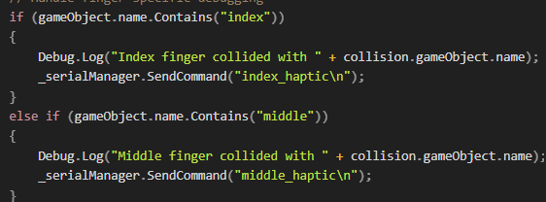
Rabiat’s Contribution
Interaction & Testing in VR
PCB Hardware Integration ready
System prepared for full 5-finger implementation:
5 flex sensor inputs (1600-3040 range)
5 haptic feedback channels
5 electromagnetic brake controls
Haptic feedback and electromagnetic system ready for hardware.
Code optimized for PCB integration
Although A challenge: Grab type detection sensitivity needs fine tuning, some inconsistency and requires full close
Notes:
Testing Multiple Scenarios
Tested various object interactions and haptic feedback scenarios to ensure the system responds properly during real-world usage.

Slide 9
THANK YOU!
End of slides

